Slide 1
BASIS DATA LANJUT
PL SQL
Oleh : (3122600003)Dukhaan Kamimpangan
Kelas : 2 D4 IT A

Slide 2
TUGAS
3
Dasar PL SQL

Slide 3
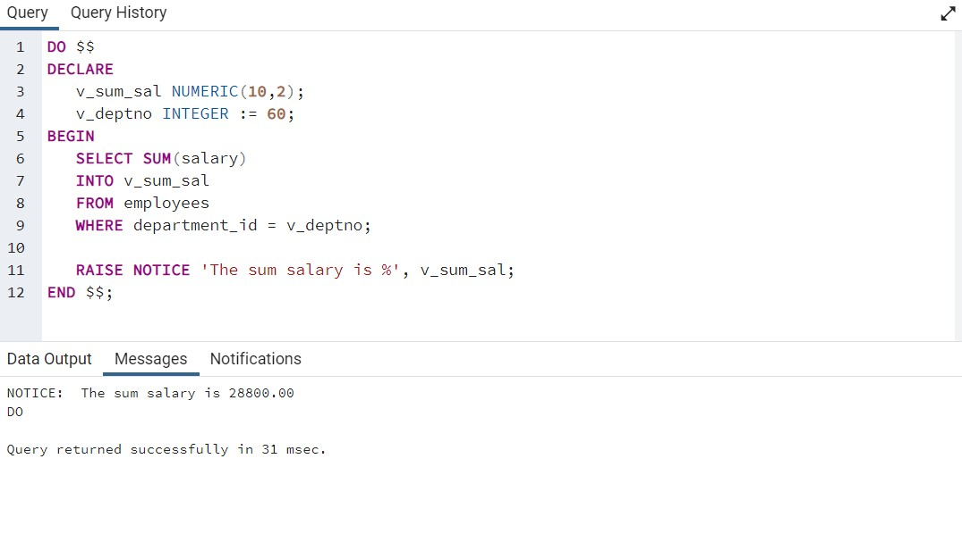
PART 1
Select Statement
DO $$
DECLARE
v_sum_sal NUMERIC(10,2);
v_deptno INTEGER := 60;
BEGIN
SELECT SUM(salary)
INTO v_sum_sal
FROM employees
WHERE department_id = v_deptno;
RAISE NOTICE 'The sum salary is %', v_sum_sal;
END $$;

Slide 4
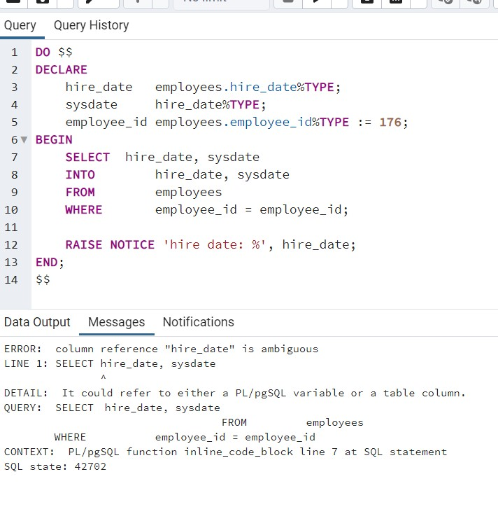
Error : Select Statement
DO $$
DECLARE
hire_date employees.hire_date%TYPE;
sysdate hire_date%TYPE;
employee_id employees.employee_id%TYPE := 176;
BEGIN
SELECT hire_date, sysdate
INTO hire_date, sysdate
FROM employees
WHERE employee_id = employee_id;
RAISE NOTICE 'hire date: %', hire_date;
END;
$$

Slide 5
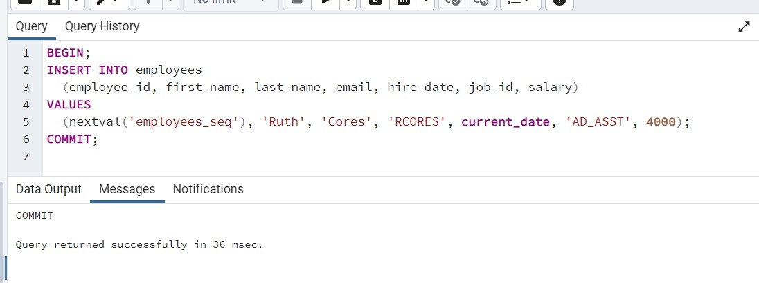
Menyisipkan Data Baru
BEGIN;
INSERT INTO employees
(employee_id, first_name, last_name, email, hire_date, job_id, salary)
VALUES
(nextval('employees_seq'), 'Ruth', 'Cores', 'RCORES', current_date, 'AD_ASST', 4000);
COMMIT;

Slide 6
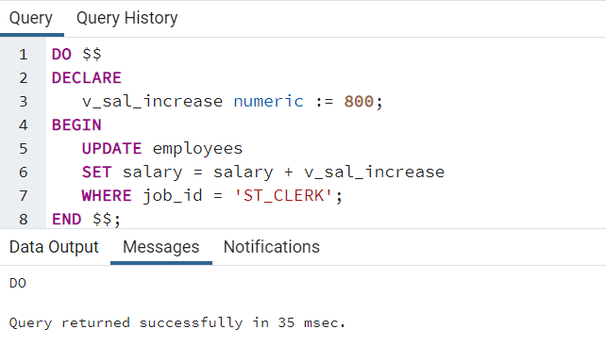
Merubah Data
DO $$
DECLARE
v_sal_increase numeric := 800;
BEGIN
UPDATE employees
SET salary = salary + v_sal_increase
WHERE job_id = 'ST_CLERK';
END $$;

Slide 7
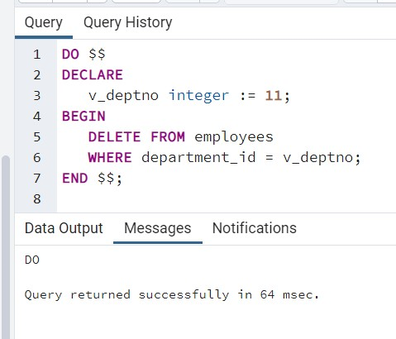
Menghapus Data
DO $$
DECLARE
v_deptno integer := 11;
BEGIN
DELETE FROM employees
WHERE department_id = v_deptno;
END $$;

Slide 8
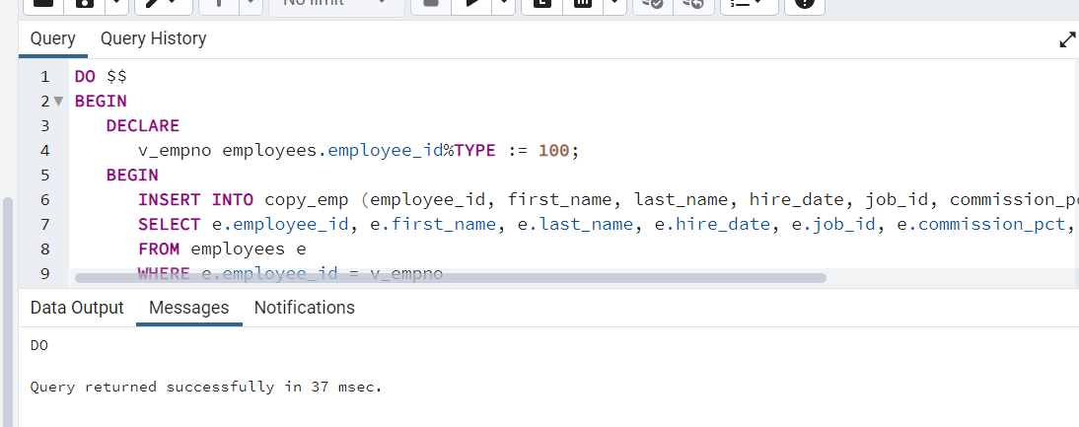
Merging Rows
DO $$
BEGIN
DECLARE
v_empno employees.employee_id%TYPE := 100;
BEGIN
INSERT INTO copy_emp (employee_id, first_name, last_name, hire_date, job_id, commission_pct, manager_id, department_id)
SELECT e.employee_id, e.first_name, e.last_name, e.hire_date, e.job_id, e.commission_pct, e.manager_id, e.department_id
FROM employees e
WHERE e.employee_id = v_empno
ON CONFLICT (employee_id) DO UPDATE
SET
first_name = excluded.first_name,
last_name = excluded.last_name,
hire_date = excluded.hire_date,
job_id = excluded.job_id,
commission_pct = excluded.commission_pct,
manager_id = excluded.manager_id,
department_id = excluded.department_id;
END;
END $$;

Slide 9
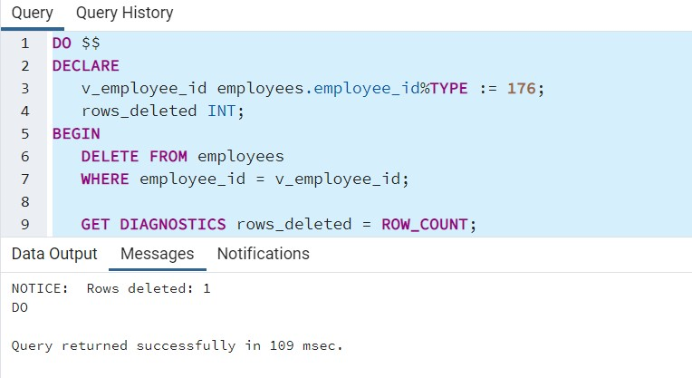
penggunaan SQL%ROWCOUNT
DO $$
DECLARE
v_employee_id employees.employee_id%TYPE := 176;
rows_deleted INT;
BEGIN
DELETE FROM employees
WHERE employee_id = v_employee_id;
GET DIAGNOSTICS rows_deleted = ROW_COUNT;
RAISE NOTICE 'Rows deleted: %', rows_deleted;
END $$;

Slide 10
TERIMA KASIH

